Slide 1


CIS 9655
EDUCATION AND CAREER SUCCESS
exploring factors Influencing career outcomes
GROUP 9
2025

Slide 2





THE TEAM
Here’s a quick little intro to our team!
MOMTAHIN MASUD
REZWAN ISLAM
ALAA
MBA
MSBA 25
Loves the beach
MSBA 25'
Loves procrastinating and video games.

Slide 3



TABLE OF CONTENTS
Introduction
Hypothesis
Methodology
Dataset 1-3
Research Paper
Dataset 4
Conclusion

Slide 4



INTRODUCTION
How much does your education really impact your career?
Does a top university guarantee a higher salary?
Do internships and networking play a bigger role than GPA?
These are some major questions we ask ourselves before pursuing a major or career.
In this analysis, we dive into four datasets to uncover the real factors that shape career outcomes in the U.S. job market. We’ll explore how various factors such as university rankings, field of study, location, and majors etc. influence salaries, promotions, and work-life balance etc in the US. Plus, we’d also like to find out if these discoveries are limited to the U.S job market or does it behave the same way in other major economies such as UK by analyzing a job market dataset from the UK.
Through interactive and insightful visualizations, this project will provide a highly detailed data-driven perspective on how education impact career success and how these factors differ across two major economies.

Slide 5


WHAT IS OUR HYPOTHESIS?
Graduates from highly ranked institutions typically start off with higher starting salaries, however this benefit is not just influenced by university ranking alone, but also by few other factors such as geographic location, field of study, internships, job satisfaction, certifications and networking.

Slide 6





TIMELINE
Brainstorm
DATA SET 1
A visual journey through key moments and milestones.
DATA SET 2 (Quantitative)
DATA SET 3 (International)
TRUST THE PROCESS
Research Paper
DATA SET 4 (Qualitative)

Slide 7



DATASET SUMMARIES
DATA SET 1
DATA SET 2
DATA SET 3
DATA SET 4
Education and career success
College salary report
UK Jobs salary
University Ranking
source: Kaggle
source: Payscale.com
source: luminate.prospects.ac.uk
source: Kaggle
Number of rows: 5000
Number of columns: 20
Data types: float64(3), int64(12), object(5)
Null values: 0
Number of rows: 1477
Number of columns: 8
Data types: int64(4), object(4)
Null values: 0
Number of rows: 10000
Number of columns: 12
Data types: int64(2), object(10)
Null values: 15756 in sum total across 3 columns
Number of rows: 1000
Number of columns: 12
Data types: float64(1) int64(2), object(9)
Null values: 0

Slide 8

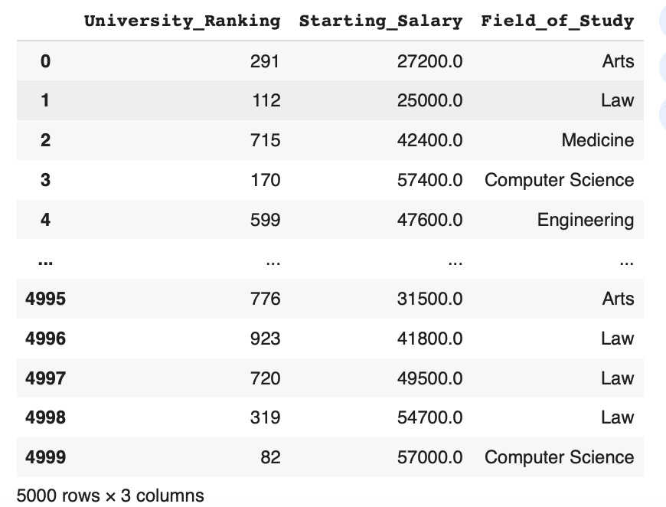
DATA SET 1
University Ranking Tiers:
Tier 1: 0-50
Tier 2: 51-200
Tier 3: 201-500
Tier 4: 500+
Notes:
masud

Slide 9
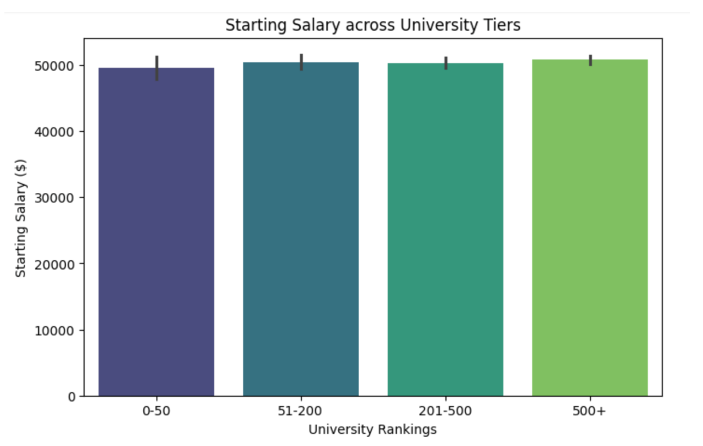
DATA SET 1
Starting median salary is around $50K
No visible difference in the starting salary across different university tiers

Slide 10
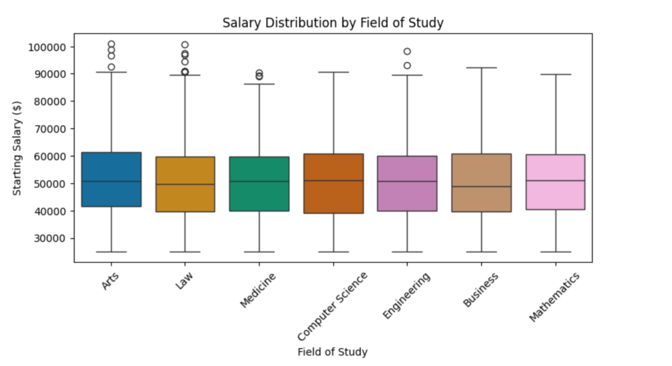
DATA SET 1
Starting median salary relatively consistent across all fields
High-earning outliers in Arts, Law & Engineering
Figure raises questions:
“Could the medical salary here be a resident salary, and not an attending salary?”...
Notes:
Ala

Slide 11
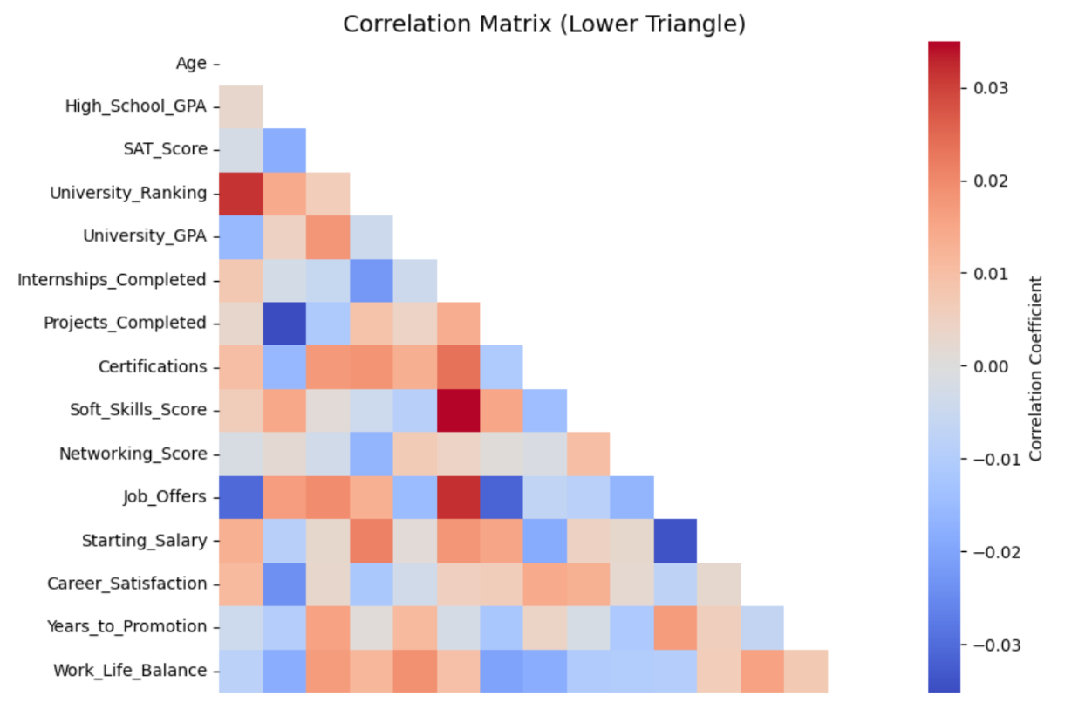
DATA SET 1
No correlation observed
Notes:
Ala

Slide 12
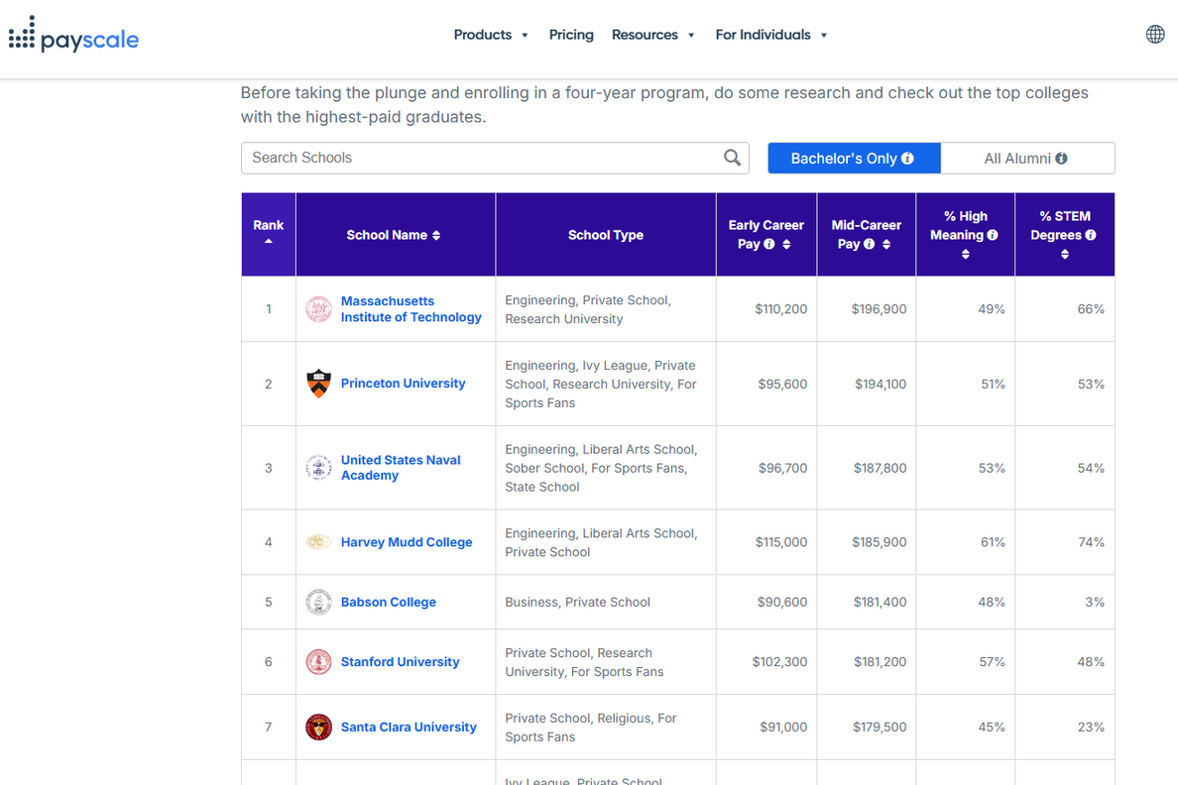
DATA SET 2
After failing to find relevant datasets, we ended up finding a website with useful information
Our Target : Webscrap this site

Slide 13
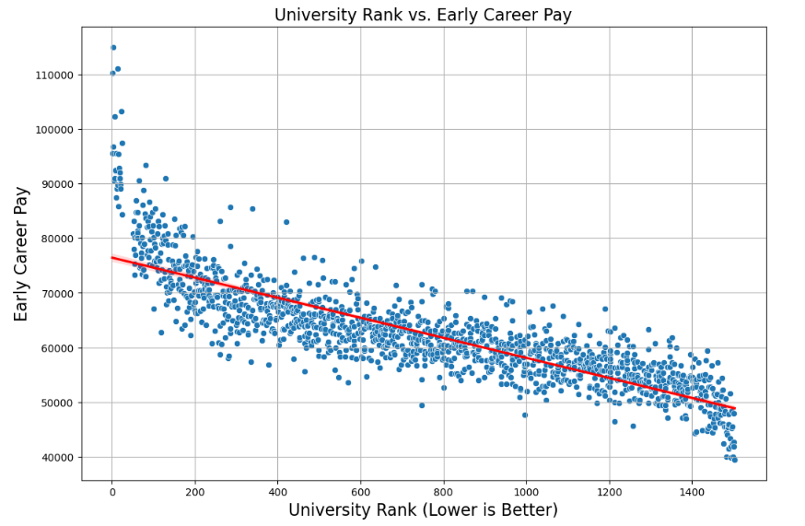

DATA SET 2
EVIDENCE EMERGES!
This visual confirms a strong correlation between university rank and starting pay!
Why is this the case?
What about late career?

Slide 14
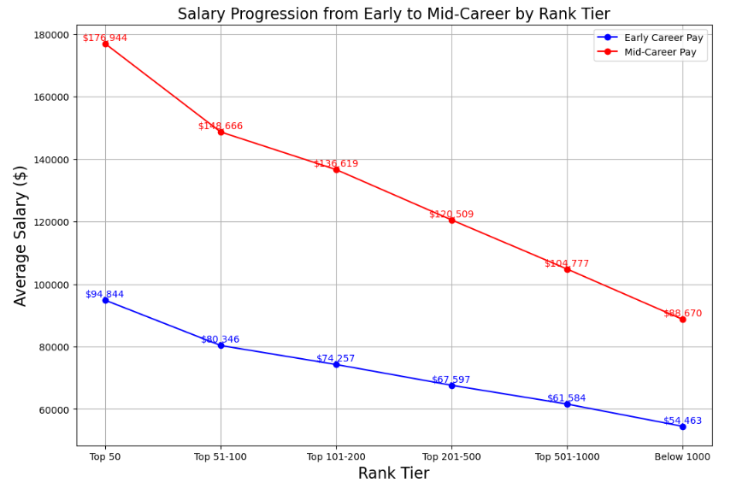

DATA SET 2
Epitome of statistical storytelling!
This graph shows that Top tier institutions consistently lead early career pay and most important a steeper mid-career growth
But still begs the question, why is this happening? What is the missing piece?

Slide 15
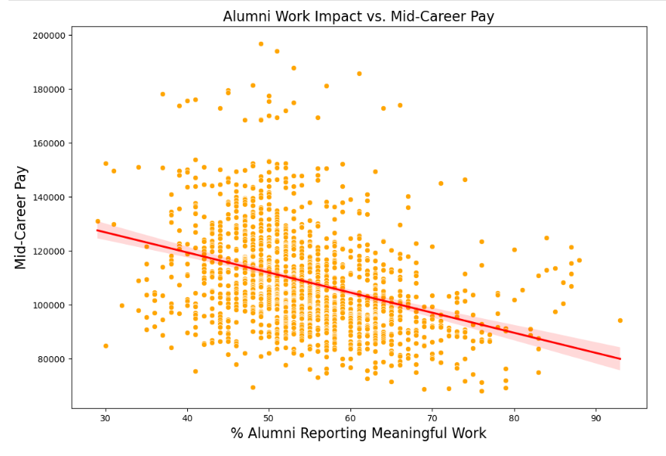

DATA SET 2
Expect the unexpected!
This chart stands against the narrative, and here is why:
Even though most top schools dominate high salary tiers, their alumni may feel less impactful in the work that they do
But this actually raises more questions than answers.
The big picture is much deeper than we initially thought.

Slide 16
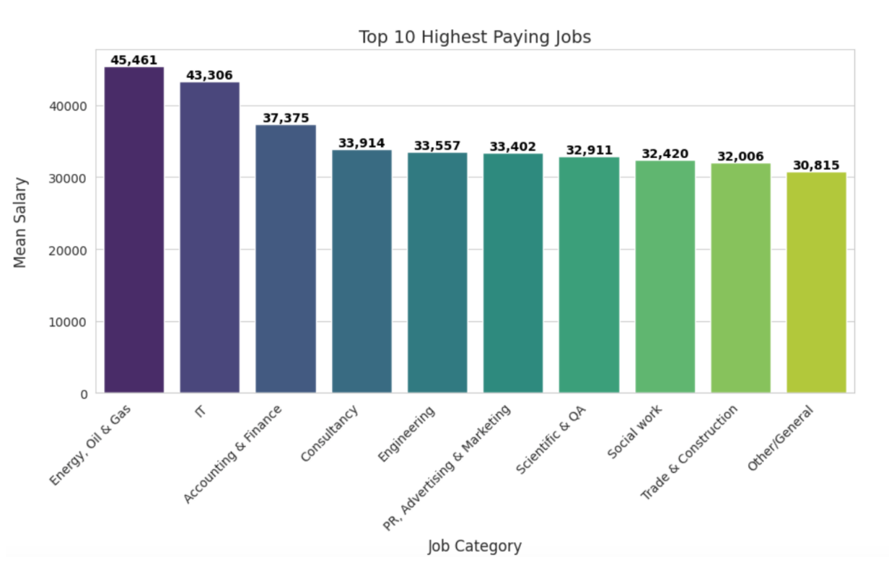

DATA SET 3
Social Work and Trade in top 10
In the UK, high-paying opportunities exist beyond traditionally high-earning industries
Notes:
Ala

Slide 17
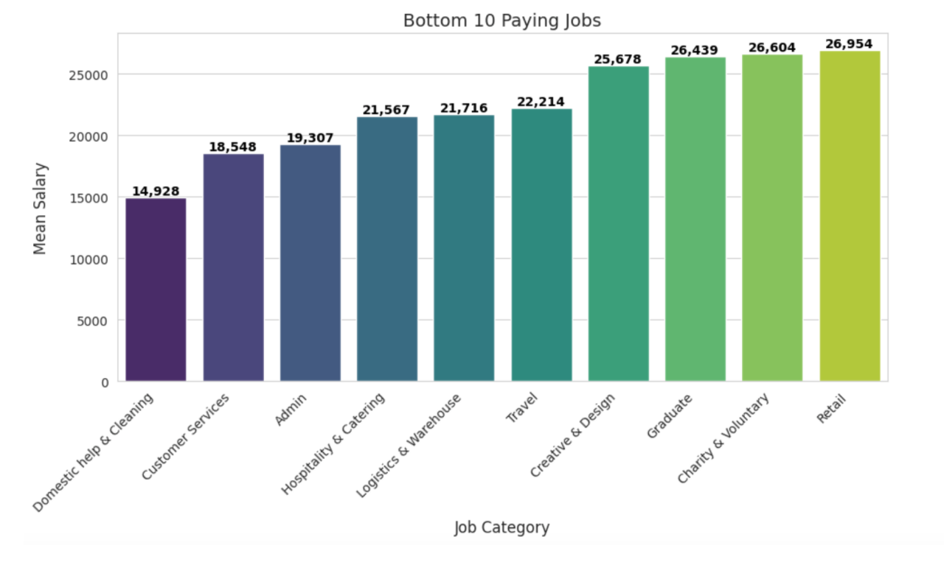

DATA SET 3
Entry-level positions
Limited employment growth
Undervalued
Domestic Help & Cleaning, Customer Services, and Admin
salary < £20,000
Notes:
Ala

Slide 18






RESEARCH PAPER
A unique approach
Hans-Georg Wolff
235 German professionals over 3 years
We must perform a qualitative analysis of our proposed hypothesis
German Psychologist
Hans-Georg Wolff is a German psychologist whose work explores career development and professional networks. His research helped us rethink success beyond just academic rankings
“Effects of Networking on Career Success,” showing how networking directly correlates with career satisfaction and salary growth
We need to stop obessing over salary related data and find the qualitative factors that make these colleges great.

Slide 19

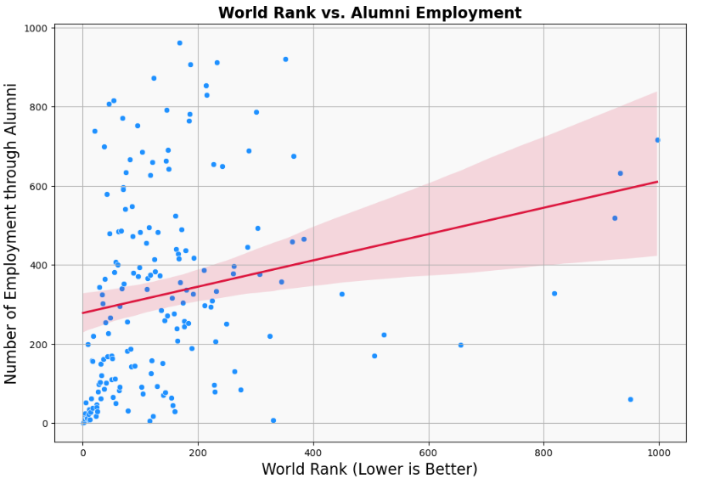

DATA SET 4
Analyzing the qualitative factors
What does this show?
There is a clear positive relationship, as the World Rank increases (worsens), the Alumni Employment rank also worsens
The fact that there are fewer strong alumni outcomes at high world ranks backs up the idea that rankings are not just for show.
The missing piece??

Slide 20

BUT CAN THIS BE FOUND IN OTHER QUALITATIVE FACTORS?
LETS FIND OUT!

Slide 21

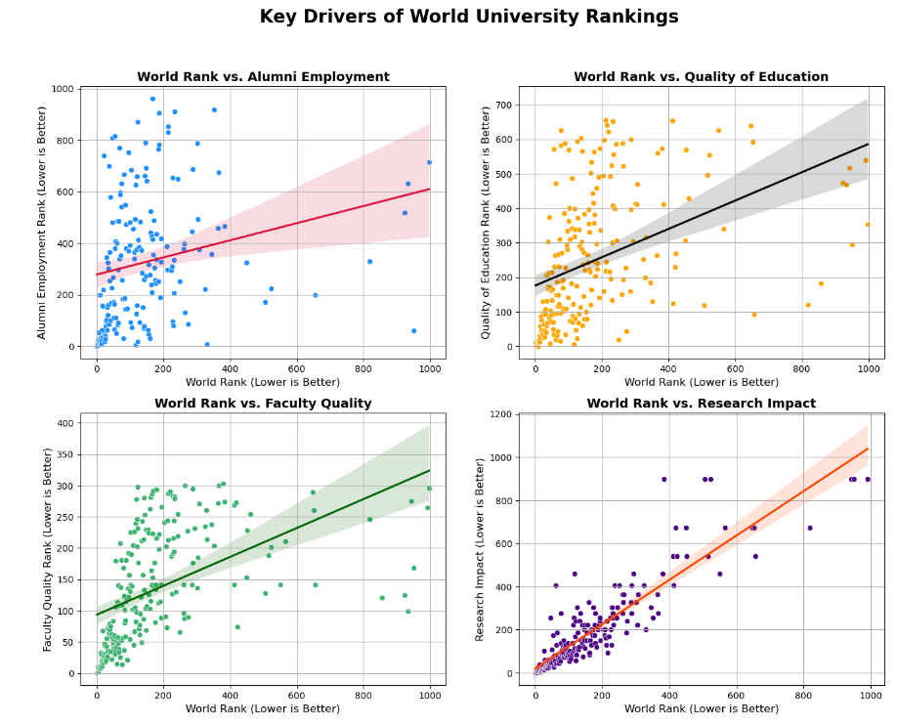
THE 4 HORSEMEN
The foundational pillars behind why rankings DO matter.
These four visuals represent the strongest factors that consistently align with high university rankings: alumni success, education quality, faculty strength, and research impact. Together, they paint a clear picture: top-ranked universities excel across the board, and their rank reflects real-world influence, not just prestige

Slide 22
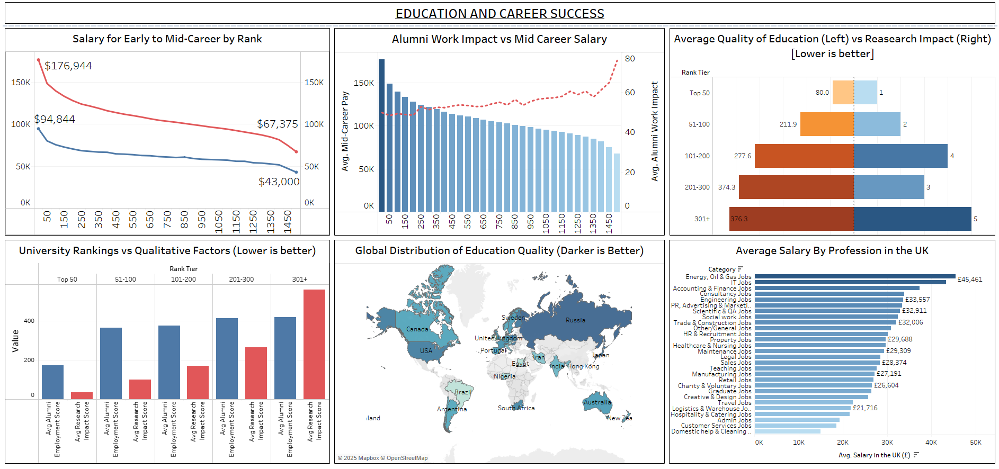
SHOW
CASE
THE TABLEAU DASHBOARD
Notes:
Rez

Slide 23

CONCLUSION
More Than Just Labels
Clear Salary Correlation
Hidden Systemic Advantages
Networking & Career Growth
Final Takeaway
Notes:
More Than Just Labels
Top university rankings reflect long-term career advantages, professional networks, and institutional influence.
Clear Salary Correlation
Higher-ranked universities consistently lead to higher salaries in both early and mid-career stages.
Earnings decline beyond the Top 200, highlighting the real-world ROI of prestigious institutions.
Hidden Systemic Advantages
Faculty quality, research output, global influence, and alumni networks drive career acceleration.
These factors are heavily concentrated in top-ranked schools.
Networking & Career Growth
Wolff & Moser’s study confirmed that networking plays a key role in salary growth and job satisfaction.
Final Takeaway
Rankings matter—not just for reputation, but for the structural advantages they provide.
However, the best university for your career may not be the best for your personal aspirations.
Choose wisely, but choose authentically.

Slide 24
THANK YOU

